Slide 1

Sending two-way radio signals on a HAB flight using LoRa
by Logan Caramanna, KC1VVU

Slide 2
My interest in ham radio
Earned my Ham Radio Technician license in 2025 (10 years old)
Interested in ham radio and long range digital to do things like:
2-way radio systems on HAB (e.g. altitude tracking)
long-range digital comms experiments

Slide 3
Problem/question
Challenge
How can I get two-way radio communication to work on a HAB flight?
My instructor said it would be a good challenge because:
“No one in StratoScience has been able to get two-way communication working yet for a flight.” – Seth Kendall, KC1PZY, StratoScience instructor

Slide 4
Hypothesis
I expect that I will:
receive a response to my message from the LoRa module on the balloon when I send it in repeated intervals from the LoRa ground station.
get mostly successful results when it’s line-of-sight to the ground station.

Slide 5
Analysis
These are some outcomes that could happen:
Balloon station receives the message sent from the ground station, stores it, sends a response, but is not received by the ground station
Balloon station receives the message sent from the ground station, stores it, sends a response, and is received by the ground station
Balloon station doesn’t receive the message sent by the ground station

Slide 6
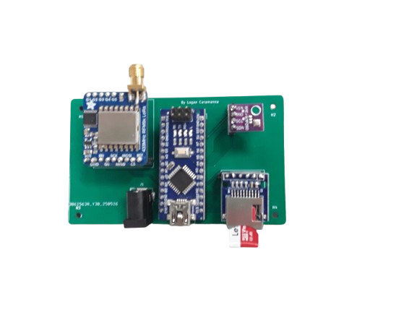
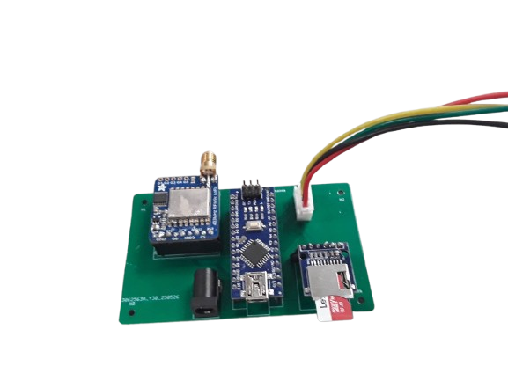
Stations
I built two stations:
Balloon station
– listen for signal from ground station
– send a reply
Ground station
– send signal to balloon station
– listen for reply
I use the same PCB for both stations.

Slide 7
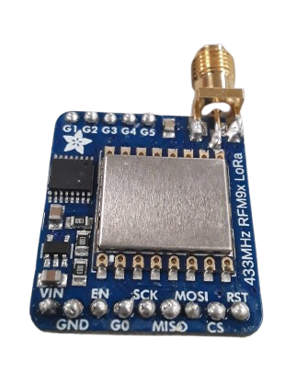
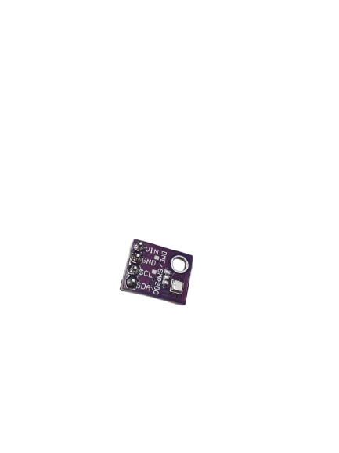
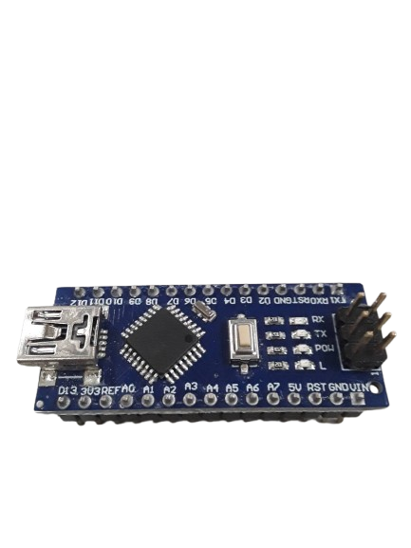
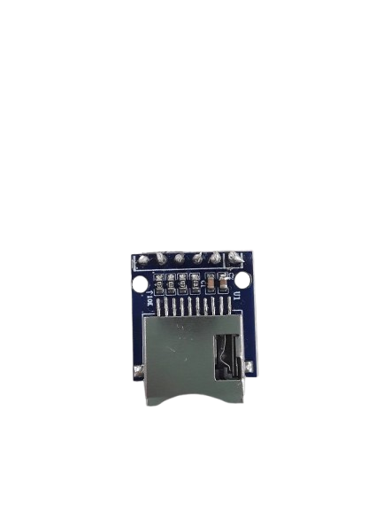
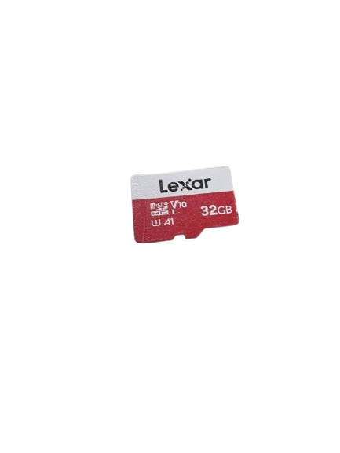
Components used
Arduino Nano
The brain
LoRa module
The radio transceiver, 433 MHz
BME280 sensor
Temperature, pressure, and humidity sensor
PCB
SD module
Reader for SD card
SD card
Storage device

Slide 8
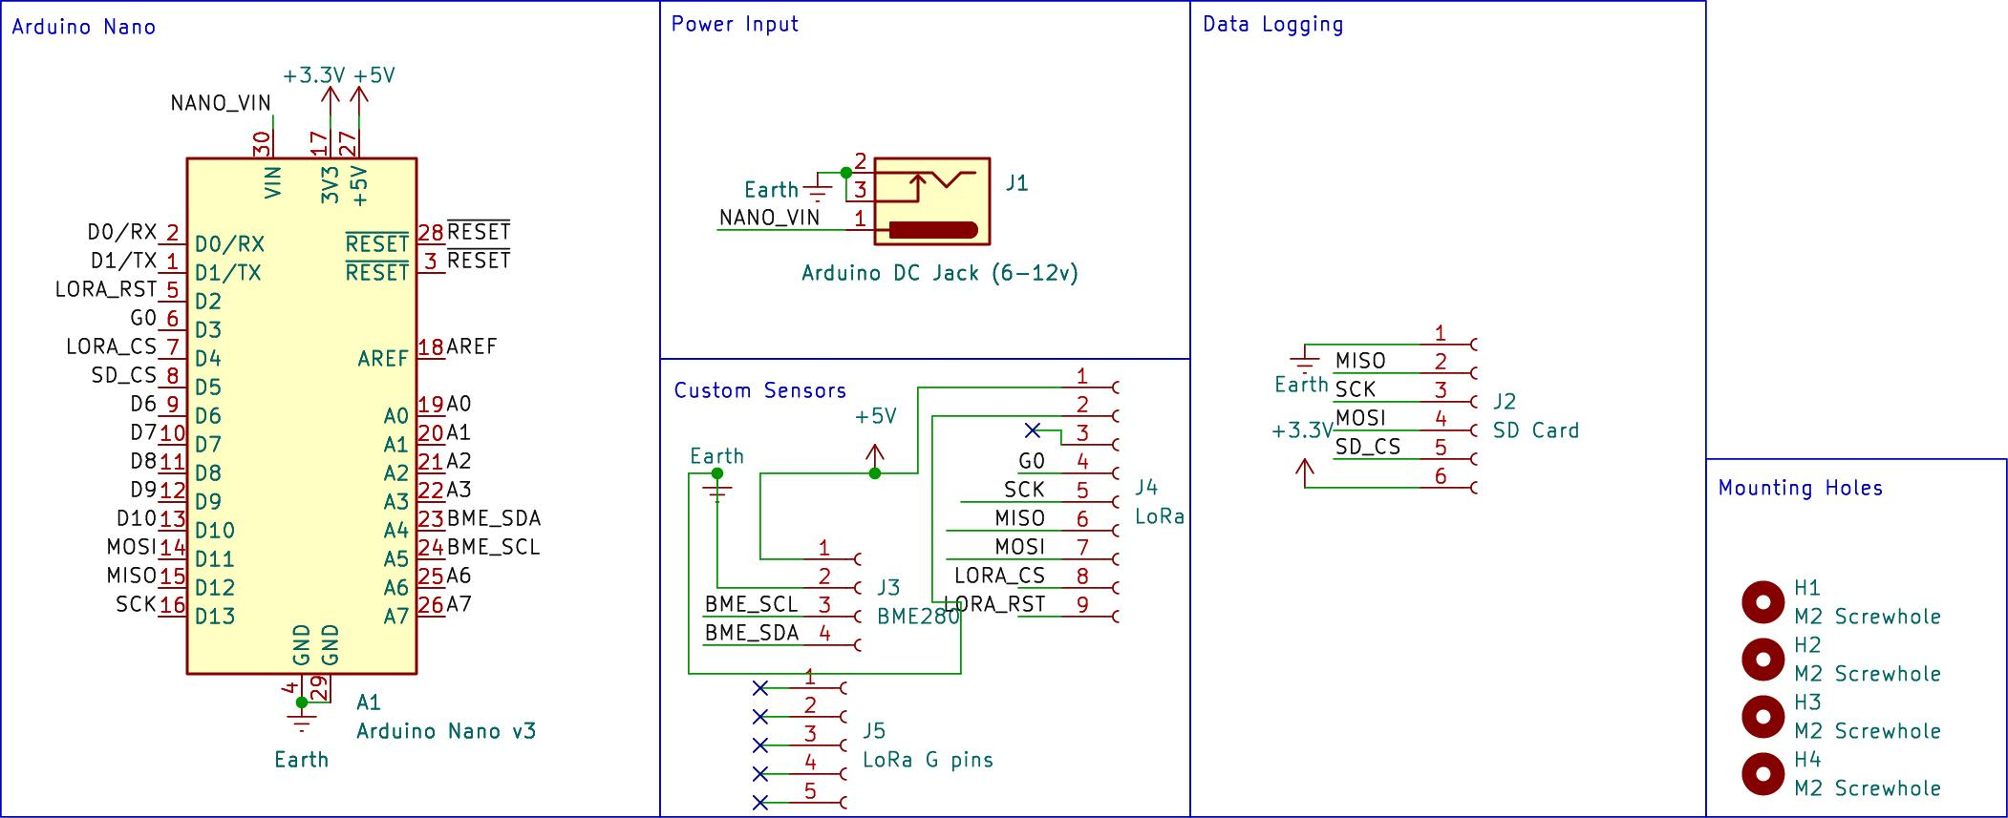
PCB design
Schematic of custom PCB that I designed using KiCad

Slide 9
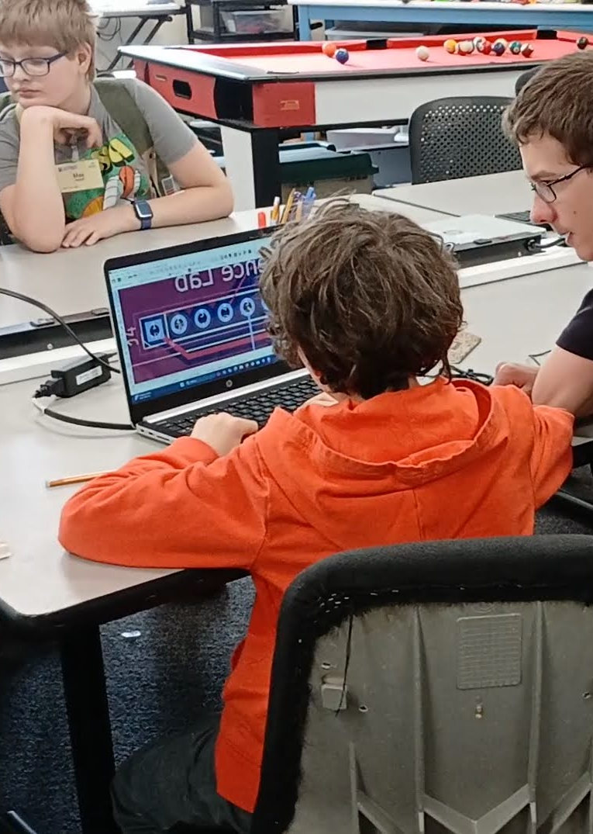
New skills I learned
Soldering
Arduino/C++ coding
Custom PCB design
Troubleshooting /
testing things systematically
HAB launch, tracking + recovery
[photo of me soldering]

Slide 10
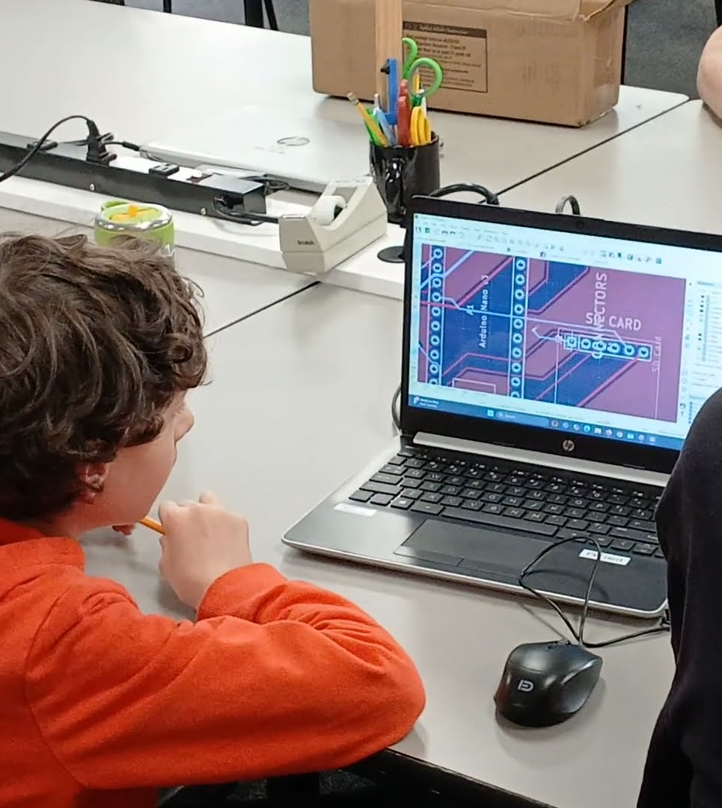
My progress so far
Designed PCB
Assembled two PCBs
Wrote code in C++
Participated in HAB launch + assisted with tracking

Slide 11
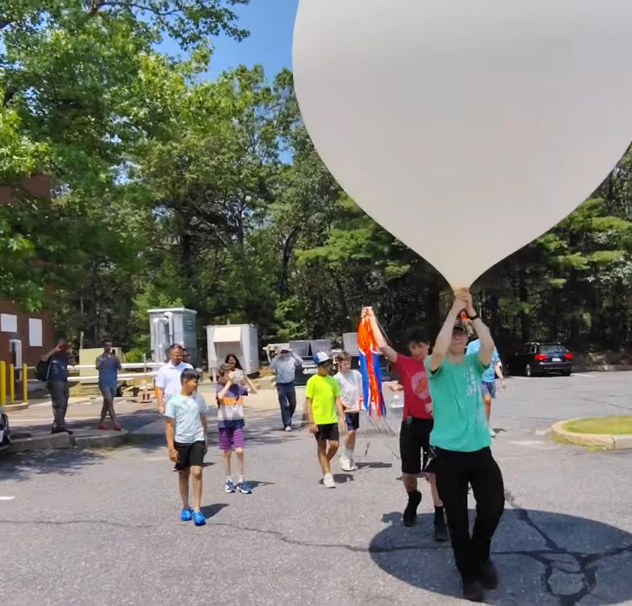
Challenges faced
More troubleshooting needed on the code to finish project
Wasn’t able to fly project this year but will continue it next year

Slide 12
Next steps
Finish working version of code
Assemble balloon station and ground station antennas
Test way to know which way to aim ground station antenna during flight
(I’m working on an app for this)

Slide 13
Thank you!

